Slide 1
HEALTHCARE RECOMMENDATION SYSTEM USING ANN ALGORITHM
Guided by
Mrs N.Vishnu Devi
ASP2/IT
Team Members:
S.Bala Subiramanian (910619205014)
S.Bogar (910619205016)
R.Navaneethan ( 910619205033)

Slide 2
ABSTRACT
Prediction of diabetes and recommend a medicine to a patient is a critical challenge in the area of clinical data analysis.
These issues raise the need to apply recommender systems in the healthcare domain to help medical professionals, make more efficient and accurate health-related decisions.
Recommender system has the ability to predict whether a particular user would prefer an item or not based on the user’s profile.
This system is developed based on classification algorithms includes Random Forest and Artificial Neural Network
ANNs Artificial neural network is usually a computational network based on biological neural networks that construct the structure of the human brain.

Slide 3
AIM OF THE PROJECT
The main objective of our project is,
To enhance the performance of the overall Accurate results.

Slide 4
PROBLEM STATEMENT
In Healthcare system The Diabetes is a most common disease caused by a group of metabolic disorders. It can be controlled by predicting this disease earlier.

Slide 5
LITERATURE SURVEY

Slide 6
MD. KAMRUL HASAN 1 , MD. ASHRAFUL ALAM1 , DOLA DAS2, ‘‘Diabetes Prediction Using Ensembling of Different Machine Learning Classifiers,’’inProc.Int.Comput.Netw.Informat.(ICCNI), vol-25 ,Apr.2022
Diabetes, also known as chronic illness, is a group of metabolic diseases due to a high level of sugar in the blood over a long period. The risk factor and severity of diabetes can be reduced significantly if the precise early prediction is possible. The robust and accurate prediction of diabetes is highly challenging due to the limited number of labeled data and also the presence of outliers (or missing values) in the diabetes datasets. In this literature, we are proposing a robust framework for diabetes prediction where the outlier rejection, filling the missing values, data standardization, feature selection, K-fold cross-validation, and different Machine Learning (ML) classifiers (k-nearest Neighbour, Decision Trees, Random Forest, AdaBoost, Naive Bayes, and XGBoost) and Multilayer Perceptron (MLP) were employed.

Slide 7
William L. Galanter, Andrew D. Boyd, and Houshang Darab “Improving the In-Hospital Mortality Prediction of Diabetes ICU PatientsUsingaProcessMining/DeepLearningArchitecture VOL.26,NO.1,JANUARY2022. Diabetes intensive care unit (ICU) patients are at increased risk of complications leading to in-hospital mortality. Assessing the likelihood of death is a challenging and time-consuming task due to a large number of influencing factors. Healthcare providers are interested in the detection of ICU patients at higher risk, they are commonly based on a snapshot of the health conditions of a patient during the ICU stay and do not specifically consider a patient’s prior medical history In this paper, a process mining/deep learning architecture is proposed to improve established severity scoring methods by incorporating the medical history of diabetes patients. First, health records of past hospital encounters are converted to event logs suitable for process mining. The event logs are then used to discover a process model that describes the past hospital encounters of patients. An adaptation of Decay Replay Mining is proposed to combine medical and demographic information

Slide 8
I. Jenhani, N. B. Amor, and Z. Elouedi, ‘‘Decision trees as possibilistic classifiers,’’ Int. J. Approx. Reasoning, vol. 48, no. 3, pp. 784–807, Aug. 2019. Diabetes is a major public health issue, with a prevalence of over 5.8 million in the USA, and over 23 million worldwide, and rising. The lifetime risk of developing Diabetes is one in five. Although promising evidence shows that the age-adjusted incidence of Diabetes may have plateaued, Diabetes still carries substantial morbidity and mortality, with 5-year mortality that rival those of many cancers. Diabetes represents a considerable burden to the health-care system, responsible for costs of more than $39 billion annually in the USA alone, and high rates of hospitalizations, readmissions, and outpatient visits.

Slide 9
M. Maniruzzaman, M. J. Rahman, M. Al-MehediHasan, H. S. Suri, M. M. Abedin, A. El-Baz, and J. S. Suri, ‘‘Accurate diabetes risk stratification using machine learning: Role of missing value and outliers,’’ J. Med. Syst.,vol.42,no.5,p.92,May2018 Diabetes may perhaps consequence in debility, severe disorder, and meager quality of lifespan. Furthermore, it could also be lethal. Hence inferring Diabetes has turn into foremost distress currently. This paper centers on various machine learning practices which assist ascertaining and perceiving innumerable Diabetes. Multifarious machine learning approaches conversed here are Hidden Markov Models, Support Vector Machine, Feature Selection, Computational intelligent classifier, prediction system, data mining techniques and genetic algorithm

Slide 10
EXISTING SYSTEM
Diabetes is one of the most significant causes of mortality in the world today. Prediction of cardiovascular disease is a critical challenge in the area of clinical data analysis.
Diabetes is very dangerous if not immediately treated on time. The existing system doesn’t effectively classify and predict the disease in human body.
Practical use of healthcare database systems and knowledge discovery is difficult in diabetes diagnosis.

Slide 11
PROPOSED SYSTEM
The proposed model is introduced to overcome all the disadvantages that arises in the existing system.
This system will increase the accuracy of the Supervised classification results by classifying the data based on the social network mental disorders and others using Decision tree classification algorithm.
It enhances the performance of the overall classification results.
Apply data mining techniques to the dataset to investigate if ML & DL techniques can achieve equivalent (or better) results in identifying suitable treatments as that achieved in the diagnosis.

Slide 12
REQUIREMENTS
SOFTWARE REQUIREMENTS:
O/S : Windows 7/8/10.
Language : PYTHON
IDE : NETBEANS IDE 8.2
Hardware requirements:
System : Pentium IV 2.4 GHz
Hard Disk : 200 GB
Ram : 4GB

Slide 13
SYSTEM ARCHITECTURE
Train set
Dataset
Pre-processed data
Classification
Test set
Prediction

Slide 14
MODULES
Data Preprocessing
ANN Classification
Splitting Dataset into Train and Test Data
Result Generation

Slide 15
MODULES DESCRIPTION

Slide 16
DATA PREPROCESSING
The data can have many irrelevant and missing parts. To handle this part, data cleaning is done. It involves handling of missing data, noisy data etc.
Missing Data: This situation arises when some data is missing in the data. It can be handled in various ways.
Ignore the tuples: This approach is suitable only when the dataset we have is quite large and multiple values are missing within a tuple.
Fill the Missing values: There are various ways to do this task. You can choose to fill the missing values manually, by attribute mean or the most probable value. •
Regression: Data can be made smooth by fitting it to a regression function. The regression used may be linear or multiple.

Slide 17
CLASSIFICATION
K-Means Clustering is an Unsupervised Learning algorithm, which groups the unlabeled dataset into different clusters. Here K defines the number of pre-defined clusters that need to be created in the process, as if K=2, there will be two clusters, and for K=3, there will be three clusters, and so on.
Random forest algorithm creates decision trees on data samples and then gets the prediction from each of them and finally selects the best solution by means of voting. It is an ensemble method which is better than a single decision tree because it reduces the over-fitting by averaging the result. Logistic Regression
Logistic Regression is a Machine Learning algorithm which is used for the classification problems, it is a predictive analysis algorithm and based on the concept of probability..
Artificial Neural Network Tutorial provides basic and advanced concepts of ANNs. Our Artificial Neural Network tutorial is developed for beginners as well as professions.. An Artificial neural network is usually a computational network based on biological neural networks that construct the structure of the human brain

Slide 18
SPLITTING DATASET INTO TRAIN AND TEST DATA
Data splitting is the act of partitioning available data into two portions, usually for cross-validator purposes.
One Portion of the data is used to develop a predictive model and the other to evaluate the model's performance.
Separating data into training and testing sets is an important part of evaluating data mining models.
Typically, when you separate a data set into a training set and testing set, most of the data is used for training, and a smaller portion of the data is used for testing.
To train any machine learning model irrespective what type of dataset is being used you have to split the dataset into training data and testing data

Slide 19
RESULT GENERATION
The Final Result will get generated based on the overall classification and prediction. The performance of this proposed approach is evaluated using some measures like,
Accuracy of classifier refers to the ability of classifier. It predicts the class label correctly and the accuracy of the predictor refers to how well a given predictor can guess the value of predicted attribute for a new data.
AC= TP+TN TP+TN+FP+FN
Precision Precision is defined as the number of true positives divided by the number of true positives plus the number of false positives.
Precision= 𝑇𝑃 𝑇𝑃+𝐹𝑃
Recall is the number of correct results divided by the number of results that should have been returned. In binary classification, recall is called sensitivity. It can be viewed as the probability that a relevant document is retrieved by the query. Recall= 𝑇𝑃 𝑇𝑃+𝐹𝑁
F-Measure F measure (F1 score or F score) is a measure of a test's accuracy and is defined as the weighted harmonic mean of the precision and recall of the test.
F-measure= 2𝑇𝑃 2𝑇𝑃+FP+𝐹�

Slide 20
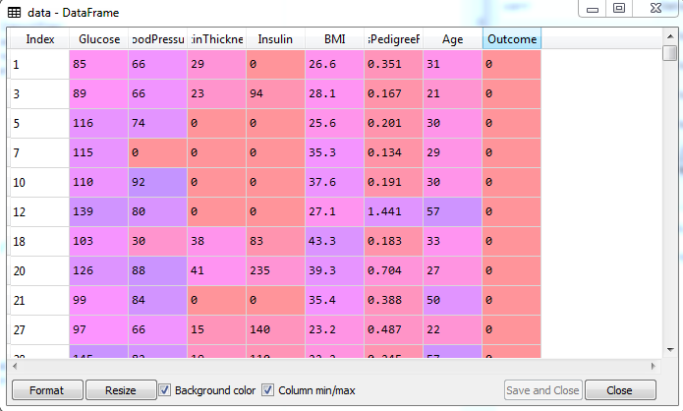
SCREENSHOTS

Slide 21
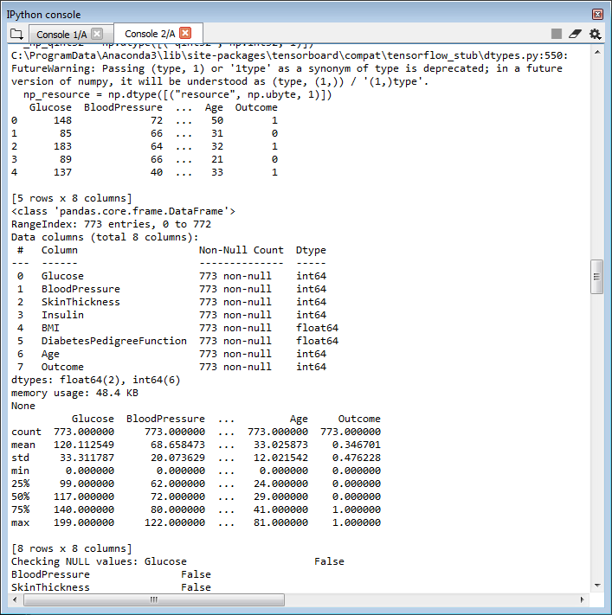

Slide 22
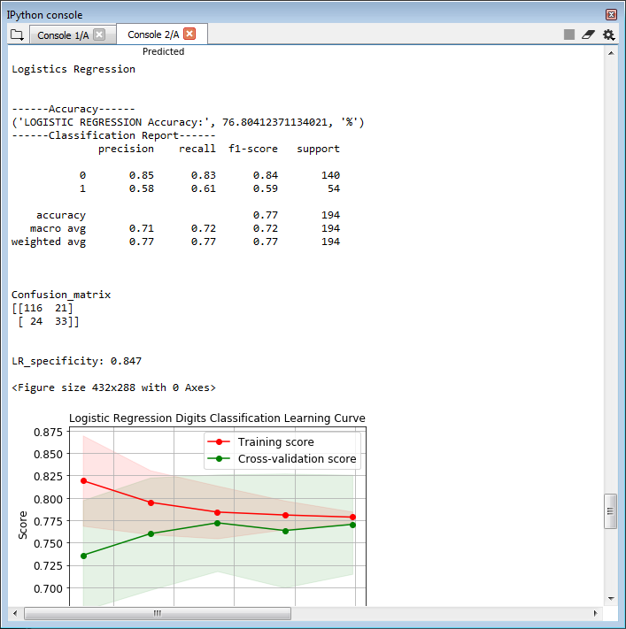

Slide 23
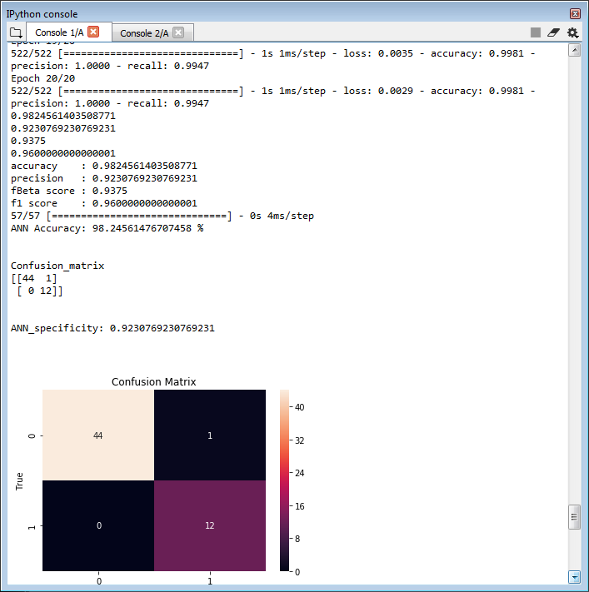

Slide 24
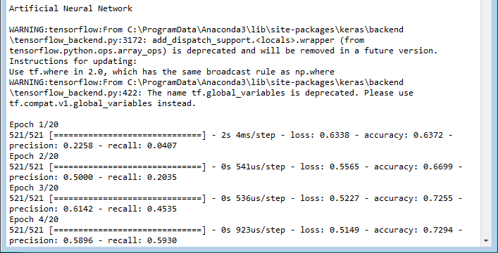

Slide 25
CONCLUSION
In this process, we present the hybrid predictive models by using machine learning method Random Forest (RF) and Artificial Neural Network (ANN) to predict diabetes disease.
By method to Improve Expected Output of Semi-structured Sequential Data. It will enhance the performance of the predicted result.
Finally generate the result based on accuracy, precision, recall and f1-score.
.

Slide 26
FUTURE ENHANCEMENT
In future, it is possible to provide extensions or modifications to the proposed clustering and classification algorithms to achieve further increased performance.
Apart from the experimented combination of data mining techniques, further combinations such as artificial intelligence, soft computing and other clustering algorithms can be used to improve the detection accuracy and to reduce the rate diabetes.

Slide 27
REFERENCES
[1] A. Misra, H. Gopalan, R. Jayawardena, A. P. Hills, M. Soares, A. A. RezaAlbarrán, and K. L. Ramaiya, “Diabetes in developing countries,” Journal of Diabetes, vol. 11, no. 7, pp. 522-539, Mar. 2019.
[2] R. Vaishali, R. Sasikala, S. Ramasubbareddy, S. Remya, and S. Nalluri, “Genetic algorithm based feature selection and MOE Fuzzy classification algorithm on Pima Indians Diabetes dataset,” in Proc. International Conference on Computing Networking and Informatics, Oct. 2017, pp. 1-5.
[3] Emerging Risk Factors Collaboration and other, “Diabetes mellitus, fasting blood glucose concentration, and risk of vascular disease: a collaborative meta-analysis of 102 prospective studies,” The Lancet, vol. 375, no. 9733, pp. 2215-2222, Jul. 2010.
[4] N. H. Choac, J. E. Shaw, S. Karuranga, Y. Huang, J. D. R. Fernandes, A. W. Ohlrogge, and B. Malandaa, “IDF Diabetes Atlas: Global estimates of diabetes prevalence for 2017 and projections for 2045,” Diabetes Research and Clinical Practice, vol. 138, pp. 271-281, Apr. 2018.

Slide 28
[5] P. Saeedi, I. Petersohn, P. Salpea, B. Malanda, S. Karurangaa, N. Unwin, S. Colagiuri, L. Guariguata, A. A. Motala, K. Ogurtsova, J. E. Shaw, D. Bright, R. Williams, and IDF Diabetes Atlas Committee, “Global and regional diabetes prevalence estimates for 2019 and projections for 2030 and 2045: Results from the International Diabetes Federation,” Diabetes Research and Clinical Practice, vol. 157, pp. 107843, Nov. 2019.
[6] J. W. Smith, J. E. Everhart, W. C. Dickson, W. C. Knowler, and R. S. Johannes, “Using the ADAP learning algorithm to forecast the onset of diabetes mellitus,” in Proc. Annual Symposium on Computer Application in Medical Care, Nov. 1988, pp. 261-265.
[7] M. Maniruzzaman, M. J. Rahman, M. A. M. Hasan, H. S. Suri, M. M. Abedin, A. El-Baz, and J. S. Suri, “Accurate diabetes risk stratification using machine learning: role of missing value and outliers,” Journal of Medical Systems, vol. 42, no. 5, pp. 92, May 2018.
[8] G. J. McLachlan, “Discriminant analysis and statistical pattern recognition,” Journal of the Royal Statistical Society: Series A (Statistics in Society), vol. 168, no. 3, pp. 635-636, Jun. 2005.

Slide 29
THANK YOU

